Slide 1
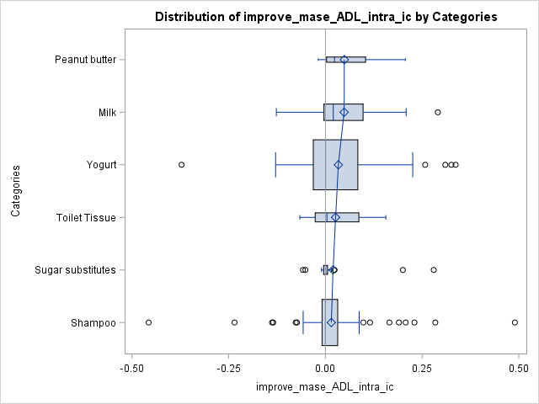
IC
Peanut butter
Milk
Yogurt
Toilet Tissue
Sugar substitutes
Shampoo
-0.4
-0.2
0
0.2
0.4

Slide 2
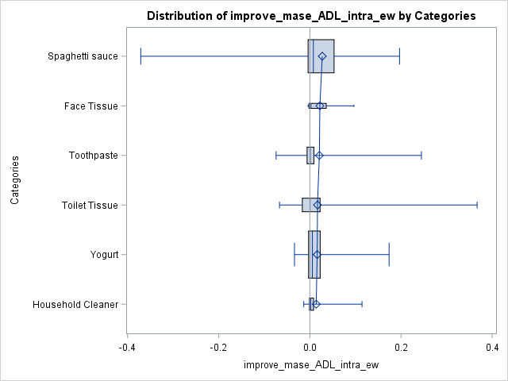
ewc
Spaghetti Sauce
Face Tissue
Toothpaste
Toilet Tissue
Yogurt
Household Cleaner
-0.4
-0.2
0
0.2
0.4

Slide 3
IC
Peanut butter
Spaghetti Sauce
Milk
Face Tissue
Yogurt
Toothpaste
Toilet Tissue
Toilet Tissue
Sugar substitutes
Yogurt
Shampoo
Household Cleaner
-0.4
-0.2
0
0.2
0.4
-0.4
-0.2
0
0.2
0.4

Slide 4
ewc
IC
Spaghetti Sauce
Peanut butter
Face Tissue
Milk
Toothpaste
Yogurt
Toilet Tissue
Toilet Tissue
Yogurt
Sugar substitutes
Household Cleaner
Shampoo
-40%
-20%
0
20%
40%
-40%
-20%
0
20%
40%

Slide 5
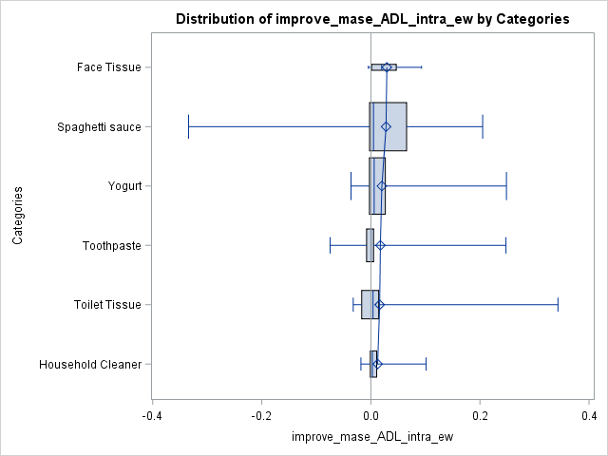

Slide 6
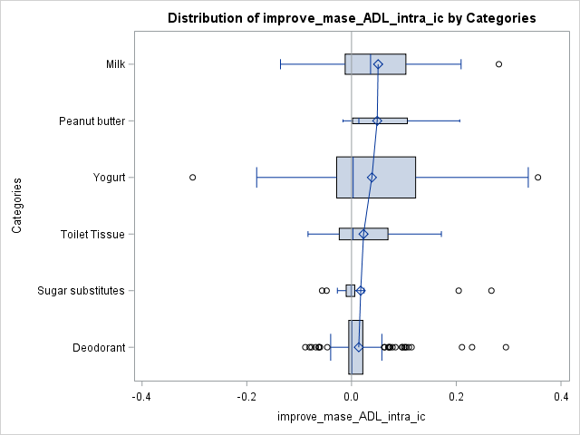
New IC
Milk
Peanut butter
Yogurt
Toilet Tissue
Sugar substitutes
Deodorant
-0.4
-0.2
0
0.2
0.4

Slide 7
New ewc
Face Tissue
Spaghetti Sauce
Yogurt
Toothpaste
Toilet Tissue
Household Cleaner
-0.4
-0.2
0
0.2
0.4

Slide 9
IC
Peanut butter
Spaghetti Sauce
Milk
Face Tissue
Yogurt
Toothpaste
Toilet Tissue
Toilet Tissue
Sugar substitutes
Yogurt
Shampoo
Household Cleaner
-0.4
-0.2
0
0.2
0.4
-0.4
-0.2
0
0.2
0.4

Slide 10
ewc
IC
Spaghetti Sauce
Peanut butter
Face Tissue
Milk
Toothpaste
Yogurt
Toilet Tissue
Toilet Tissue
Yogurt
Sugar substitutes
Household Cleaner
Shampoo
-40%
-20%
0
20%
40%
-40%
-20%
0
20%
40%

